Slide 1
Project Presentation of CO-OP Project at Industry (Module-2) (22CS421)
On
Comparative and Hybrid Analysis of Statistical Machine Learning and Deep Learning Models
Devashish Singh Thapa¹,Aditya Singh²,Nitasha³
2210990264,2210990073,2210991996
Supervised By
Lekha Rani⁴ ,Dr Gurpreet Singh⁵
Department of Computer Science and Engineering,
Chitkara University, Punjab

Slide 2

<Text Times New Roman>
2

Slide 3
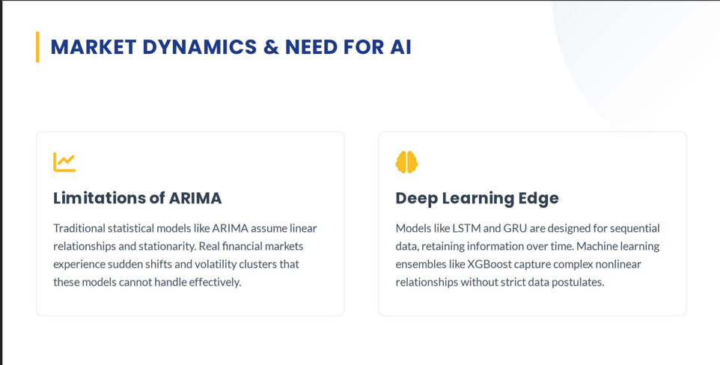

Slide 4
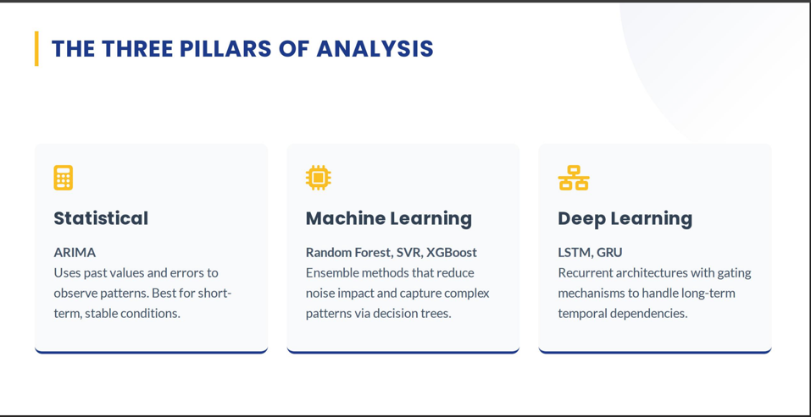

Slide 5
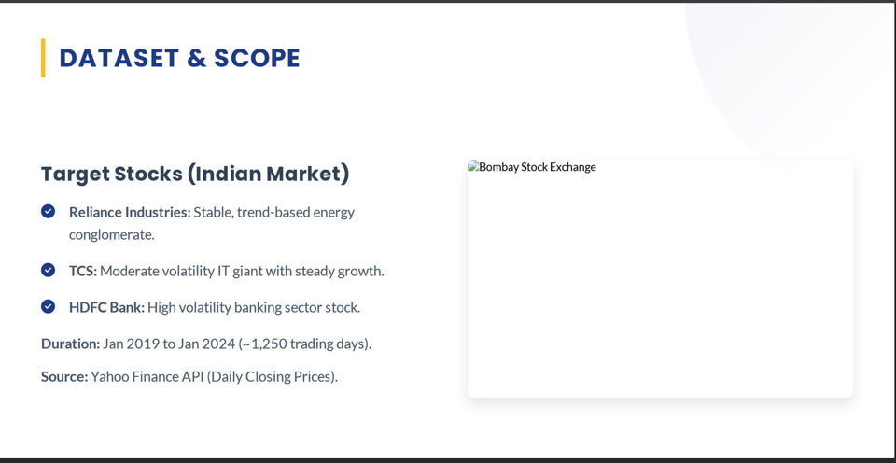
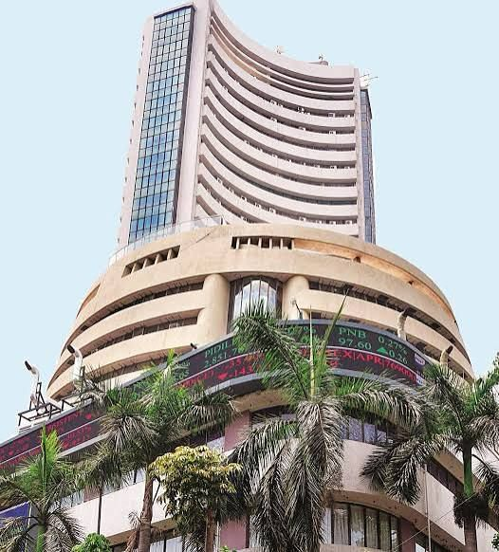

Slide 6
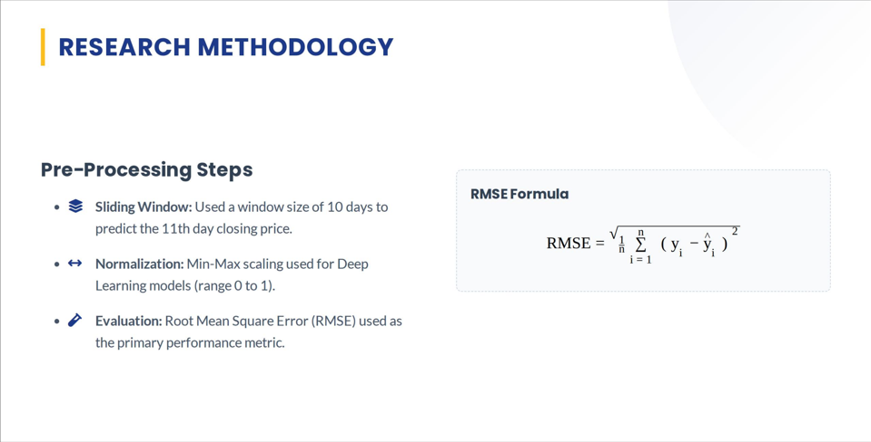

Slide 7
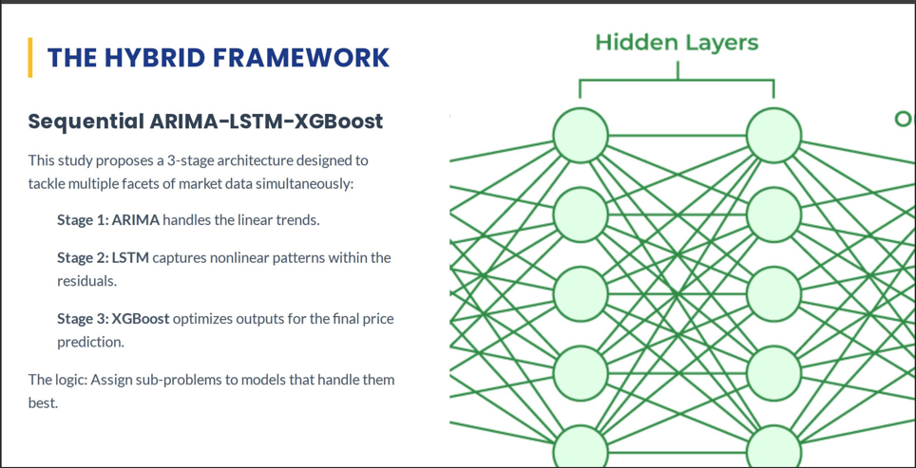

Slide 8
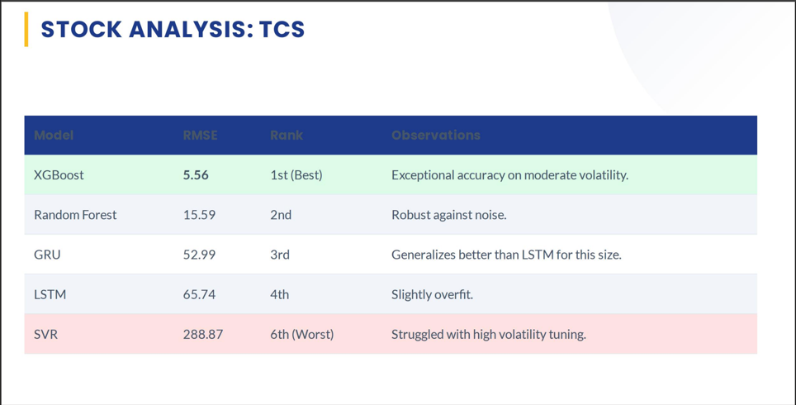

Slide 9
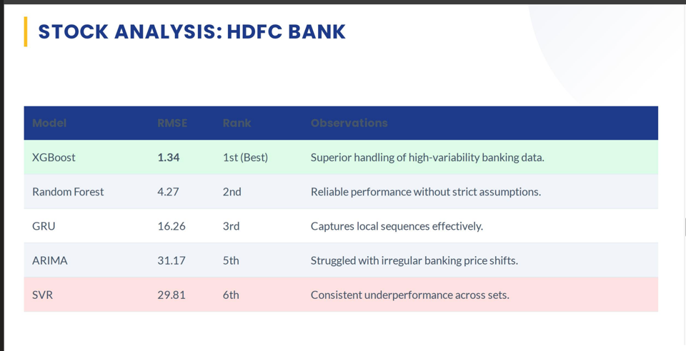

Slide 10
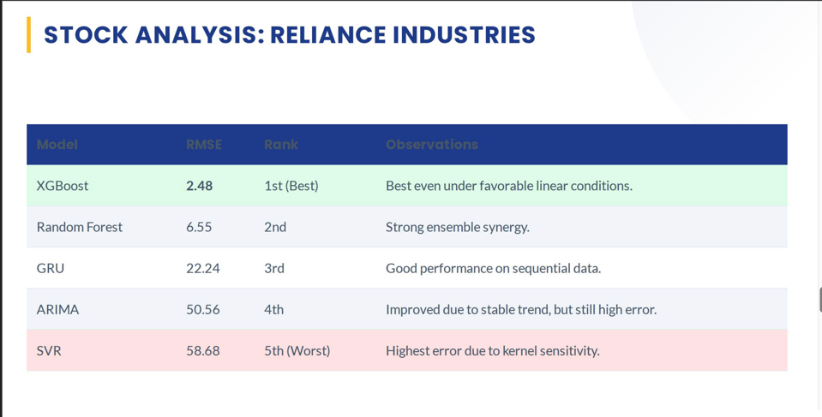

Slide 11
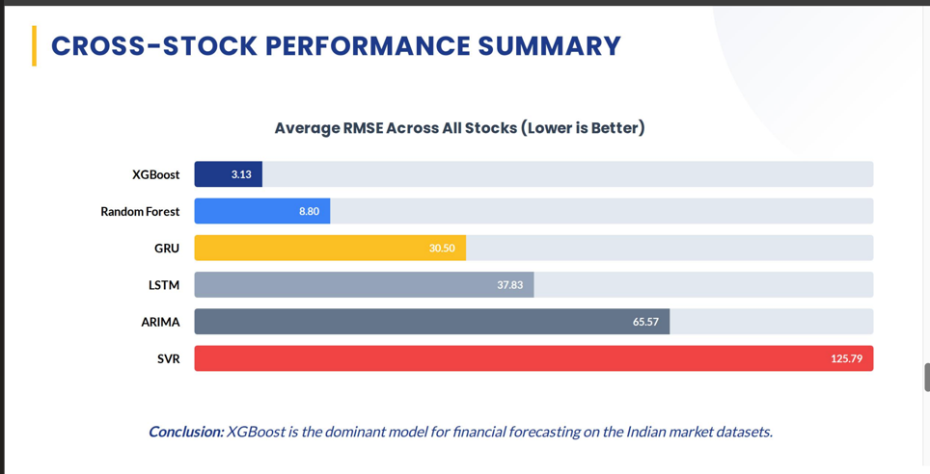

Slide 12
Thank You
12

